Slide 1


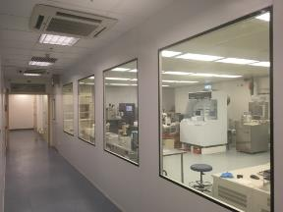
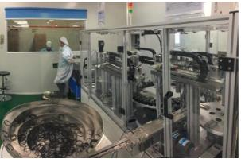
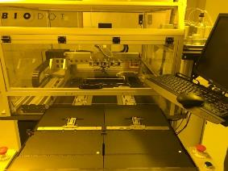

Solutions for Engineering & Manufacturing
HTI Cupping prototype UI
HTI Confidential Information

Slide 2
Suction Level
Heating Level
Vibration Level
Timer
Battery Charging Indication
Suction
Vibration
Heating
Timer
HTI Confidential Information

Slide 3
Vibration Level
Suction
Vibration Level
Press “Vibration” button
3 levels with PWM controlled vibration
(100%,60%,30%)
number of LED lighted represented the level strength
Vibration
Heating
Timer
HTI Confidential Information

Slide 4
Suction Level
Suction
Suction Level
Press “Suction” button
3 levels of suction pressure maintained by means of PWM control
number of LED lighted defines the negative pressure (TBD)
Vibration
Heating
Timer
HTI Confidential Information

Slide 5
Heating Level
Suction
Heating Level
Press “Heating” button
3 temperature of maintained by means of PWM control
number of LED lighted represented the 3 selected temperature (assume 37,40,45)
Vibration
Heating
Timer
HTI Confidential Information

Slide 6
Timer
Suction
Timer Level
Press “Timer” button
3 treatment time available
number of LED lighted represent 5min,10 min or 15 min treatment time
Vibration
Heating
Timer
HTI Confidential Information

